Slide 1
FRAUD AWARENESS FOR SENIORS

Slide 2
Over 6000 seniors become victims of fraud each year in Alberta
Most frauds are not reported because victims often feel embarrassed
DO NOT FEEL EMBARRASSED
If you think you may have been victimized, please report it to the police.

Slide 3
Why Are Seniors a Target?
Criminals know that many seniors;
Have more available finances
Are very trusting and eager to help someone in need
Are retired, creating more free time

Slide 4
Be Aware!
Criminals want to gain your trust and confidence
Remember, if it sounds too good to be true it probably is
Be careful of who you trust

Slide 5
Types of Fraud
Telemarketing
Identity Theft
Internet / E-mail
Pyramid Schemes
West African/Nigerian Letter Scam
Credit Card / Debit Card

Slide 6
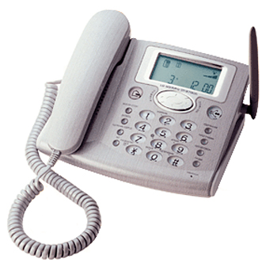
Telemarketing Fraud

Slide 7
Telemarketing Fraud Statistics
From 1996 to 2003, Canadians lost over $44,000,000 to Telemarketing fraud
Seniors represent 85% of all victims of Telemarketing Fraud

Slide 8
Telemarketing Fraud Statistics
Most telemarketing is LEGAL
However, common examples of fraudulent telemarketing are:
The Car Pitch
The Cash Pitch
The Prize Pitch
The Recovery Pitch

Slide 9

The Car Pitch
“YOU HAVE WON A CAR, please send the money UP FRONT for taxes, insurance, and shipping charges….”

Slide 10

The Cash Pitch
“Congratulations! You have just WON $1,000,000!!! You will get your money ASAP… all we need is money for taxes, broker fees, bank transfers, etc.”

Slide 11
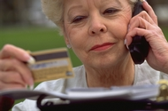
The Prize Pitch
“Your name was drawn for a “free” (prize)… first you must buy our ($10,000) ‘stamp collection’ in order to be eligible for the prize.”

Slide 12
The Recovery Pitch
Aimed at previous victims of fraud.
Claiming to be the police
Asks for recovery fees

Slide 13
Prevention Techniques
If you have won something… It will NEVER cost you anything! There is NO prize fee in Canada.
Don’t assume everyone is honest.
Don’t get pressured into making a quick decision.
Have a plan to speak to telemarketers and don’t be afraid TO HANG UP.
NEVER give out personal information over the telephone.

Slide 14
Prevention Techniques
Talk to a friend or relative before making a decision.
Ask the caller questions and information on their business
Avoid getting on phone lists
Tell the telemarketer “Put my number on your don’t call list”
Screen your calls
CALL THE POLICE with any suspicious calls or mailings

Slide 15
Prevention Techniques
Beware of Charity Scams!
Telephone Solicitations
  Casual mention of issues such as Mayerthorpe Fallen Four Memorial Park.
  Other events during these calls.
The POLICE DO NOT raise funds this way.

Slide 16
Prevention Techniques
What to do??
Ask direct and specific questions about WHO is requesting funds and the PURPOSE the money will be used.
Get the DETAILS
  Name, phone number, address of organization.
  Ask for information to be mailed out to you so you can be better informed before making a commitment.

Slide 17
Prevention Techniques
Use Caution…
Be cautious when providing personal/private information over the phone such as financial info (credit card numbers)
Take some time to learn where your money will be going
If uncomfortable making donations over the phone, request written material

Slide 18
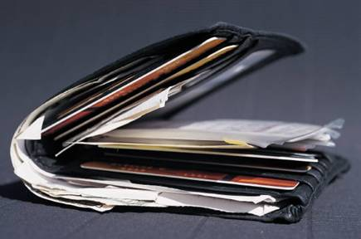
Identity Theft

Slide 19
Identity Theft
Occurs when someone steals or obtains your identification documents in order to impersonate you for reasons including financial fraud and criminal activities.
These documents include:
        Driver’s License
        Birth Certificate
        SIN Card
        Passport
        Citizenship card
        Permanent Resident card

Slide 20
Identity Theft
Criminals may obtain your info by…
Theft of wallets, purses.
Mail Theft
Vehicle Theft / Theft from Vehicle
Dumpster-Diving
Shoulder-Surfing
Card Skimming
E-mail / Web Site Spoofing

Slide 21
Identity Theft
Three Ways to protect yourself from Identity Theft;
Guard your personal information.
Keep your computer and it’s contents safe.
Be vigilant.

Slide 22
Identity Theft
If you believe your identity may have been stolen:
Contact the police
Call your credit card companies and financial institutions
Call Human Resources Development Canada If your SIN card is missing
Call Phone Busters
Call RECOL (Reporting Economic Crime Online)

Slide 23

Internet and E- Mail Fraud

Slide 24
Internet and Email Fraud
Internet and e-mail are great resources
Criminals search for victims on the internet
Criminals use this method more often with the same scams they use over the phone
Research unknown companies. Look for “secure” sites when ordering on the internet

Slide 25
Internet Hoax Example
After the events of Hurricane Katrina, many wanted to make donations to the victims of the disaster
However, many criminals took advantage of the situation by creating fake donation web sites
The FBI estimated 2,300 fraudulent web sites

Slide 26
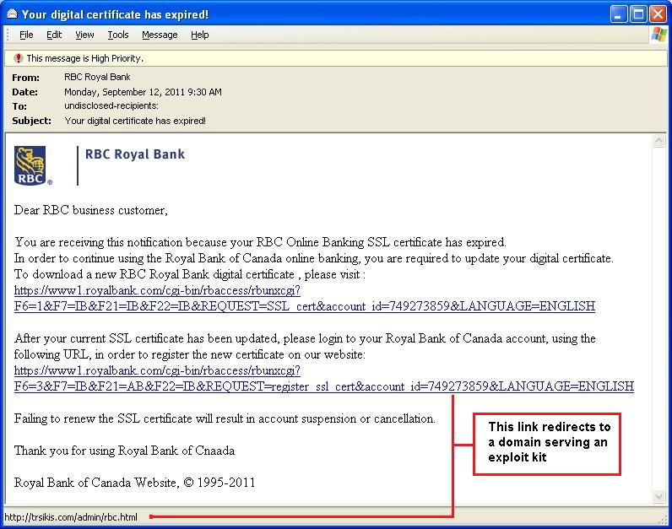
Example of email Phishing
Recipient isn’t to a
specific person.
Link text looks real
but actual URL
is to fake domain.
Threat of immediate
action being
needed “or else.”

Slide 27
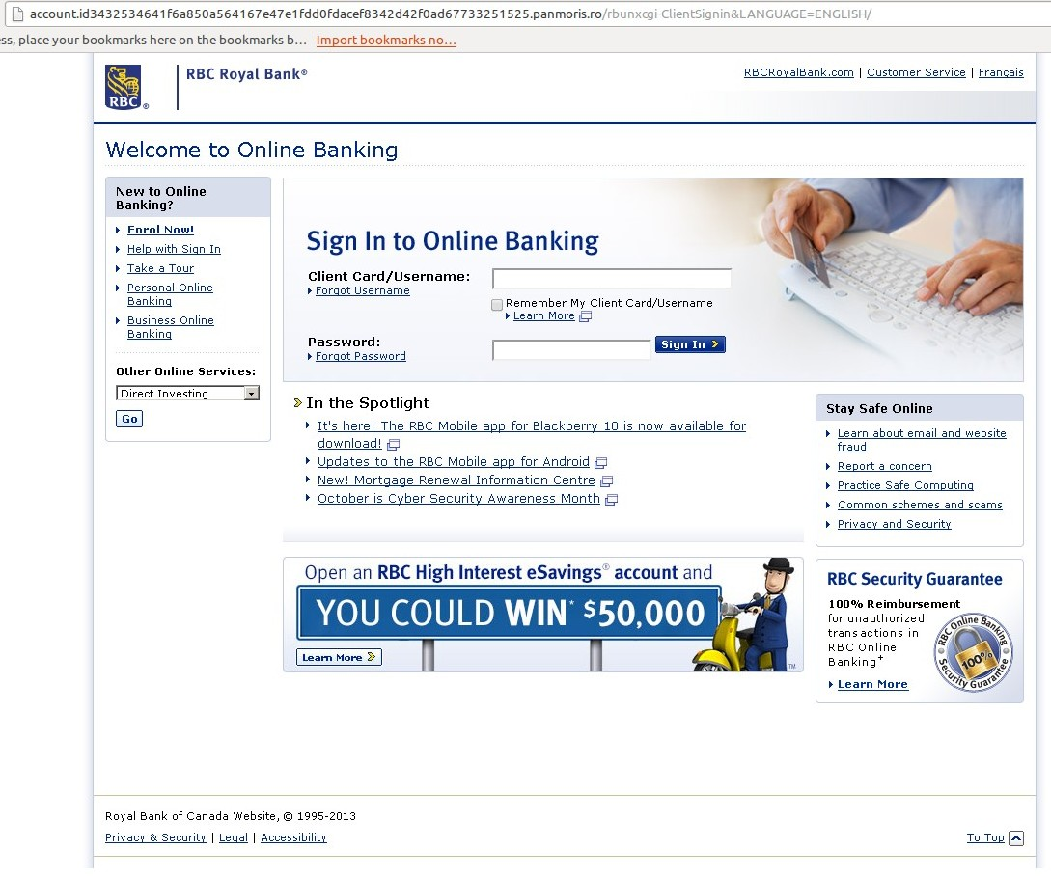
Example of website Phishing
The website looks legitimate but notice the website URL is not RBC.com

Slide 28
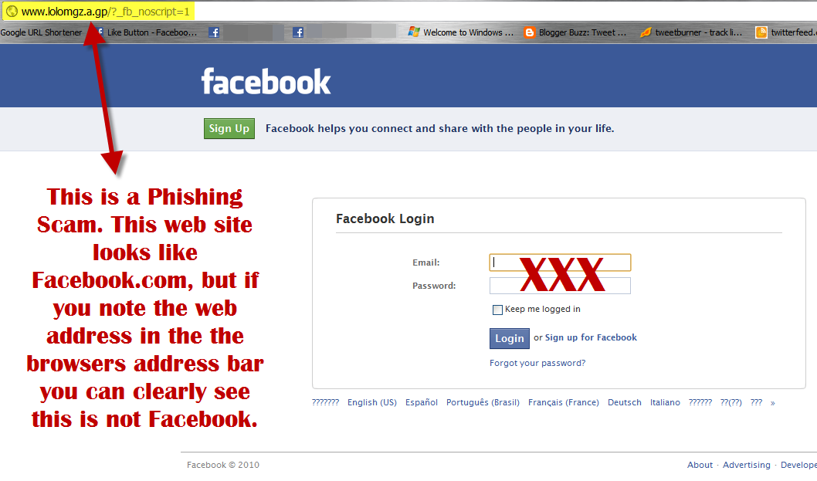
Example of website Phishing

Slide 29
Prevention Techniques
Avoid using your credit cards or bank accounts over the internet, unless dealing with well known, reputable organizations
Make your computer safe with virus, and spy ware protection
Be critical of E-mails and web sites with exciting promotions
If it sounds too good to be true, it probably is!

Slide 30
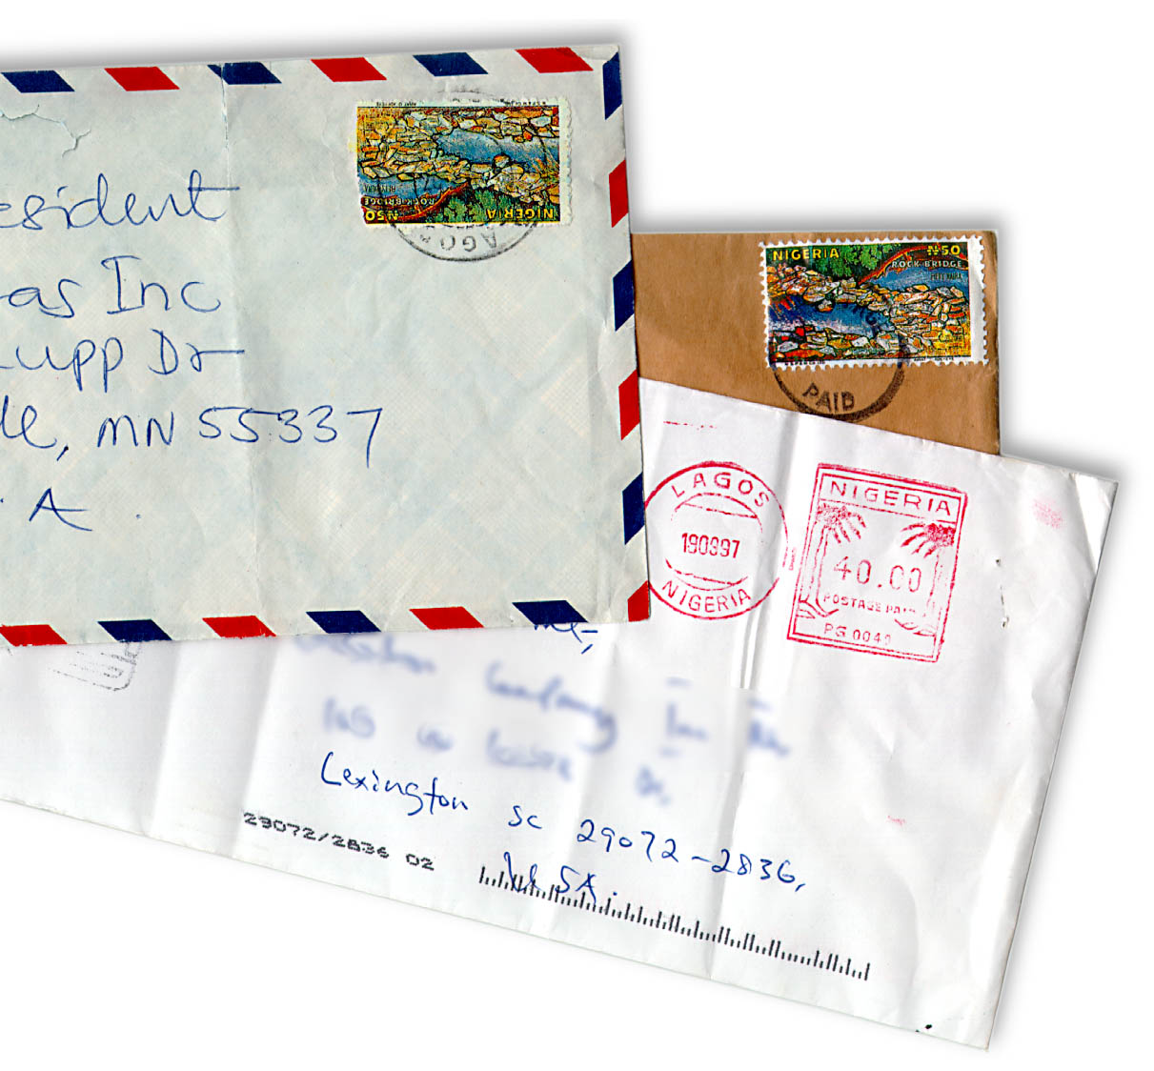
Nigerian/West African
Letter Scam

Slide 31
How it works…
You receive unsolicited e-mail, fax, or letter, often marked “with strict confidence” or “strictly confidential”
Sender is often a member of a “contract review panel”
Sender has received money and needs your assistance

Slide 32
How it works…
Depositing money into your personal account
To complete the transaction they will request your telephone #, fax #, address, & bank account information
What are they promising to share with you?

Slide 33
Nigerian Letter Scam
The RCMP estimates that Canadians have lost over $30,000,000 to the scam over the last 10 years
10,000- 15,000 variations of letters have circulated Canada
Many letters are poorly written with many grammatical errors
Remember, be wary of letters where “Urgency and Secrecy” are key elements

Slide 34
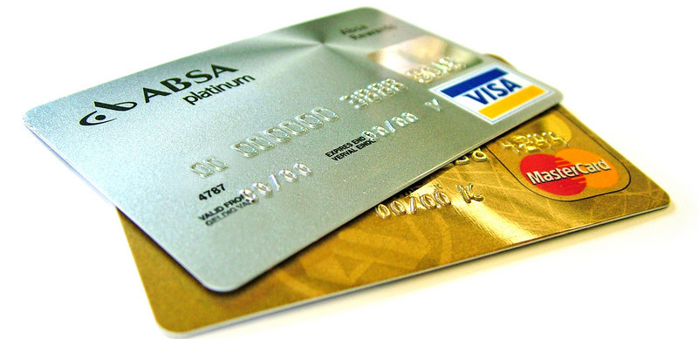
Credit Card / Debit Card Fraud

Slide 35
Credit Card Fraud
One of the fastest growing crimes in the world
Credit card fraud has become one of the world’s most lucrative crimes amounting to losses of $300,000,000 in Canada and over $5,000,000,000 worldwide each year
Criminals will often try and steal the card itself or take information from receipts and statements

Slide 36
Debit Card Fraud
Criminals will try to steal your card and PIN
Criminals need both your card and you PIN to access your account. If both the card and the PIN are kept safe, the crime is prevented
Some criminals may use elaborate techniques such as ‘skimming’ and hidden ATM video cameras to gain access to your account

Slide 37
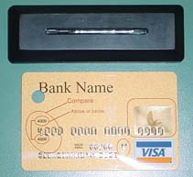
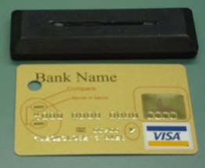
Card “Skimming”

Slide 38
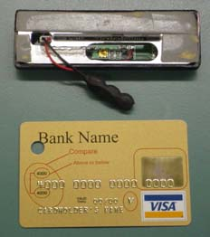
Card “Skimming”

Slide 39
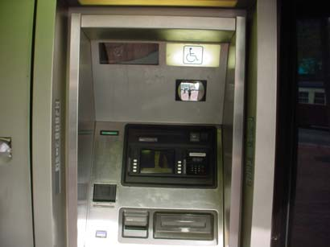
Card “Skimming”
A security mirror is placed in view of the keypad.

Slide 40
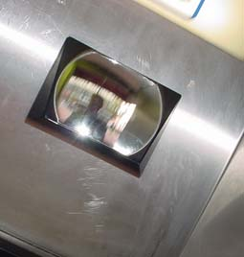
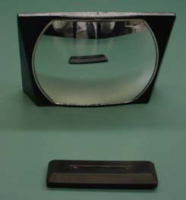
Card “Skimming”
A small video camera inside the security mirror which records the keypad.

Slide 41
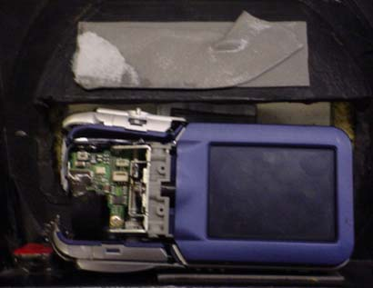
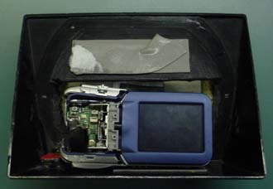
Card “Skimming”
The images and information gathered are transmitted by radio-signal to a computer a distance away.

Slide 42
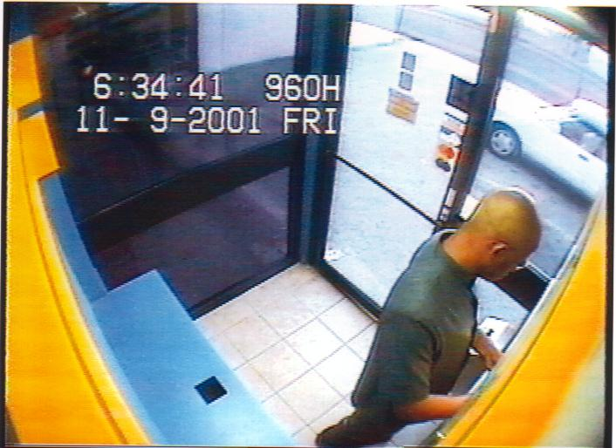
ATM SCAM
At first glance it would appear as though this individual is simply performing a simple ATM transaction

Slide 43
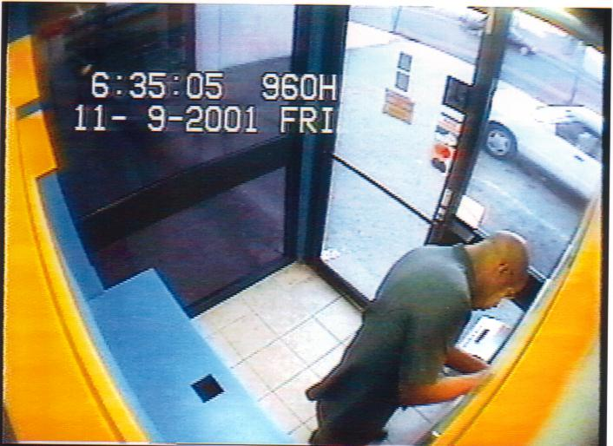
Setting the Trap
What he is in fact doing is rigging the slot on the machine so as to capture the card of the next person who uses the ATM

Slide 44
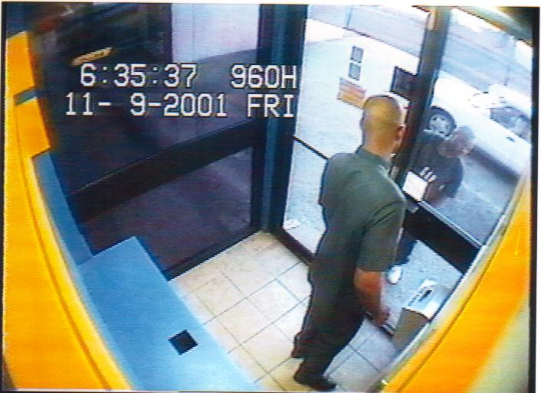
The Lookout
Rigging the machine is very risky business therefore the services of a “lookout” is required in order to warn of possible witnesses and/or potential victims

Slide 45
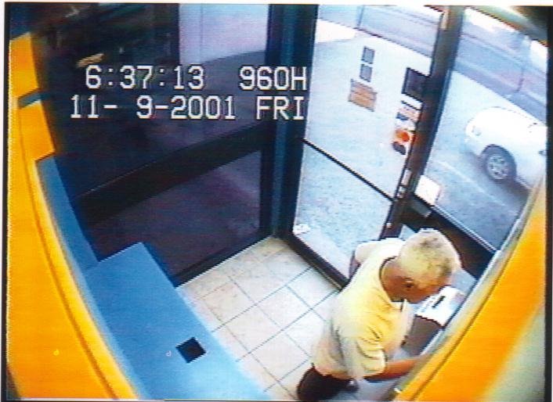
The Victim
Here we see the next customer to use the machine after the trap has been set. He inserts his card and attempts a transaction

Slide 46
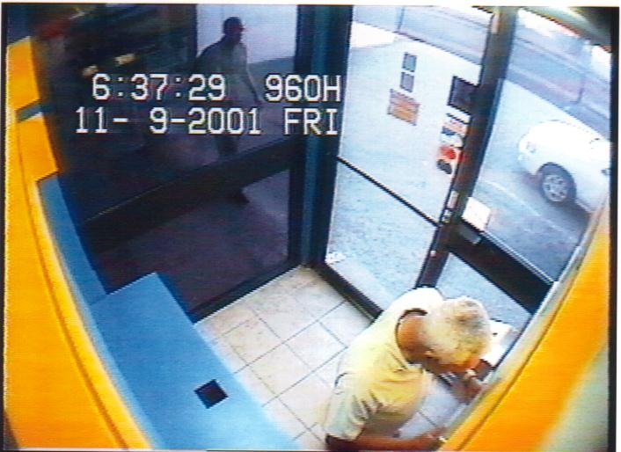
The Capture
The card has been captured and the customer is confused as to why this is so. However in the background we see that help is on its’ way……or is it?

Slide 47
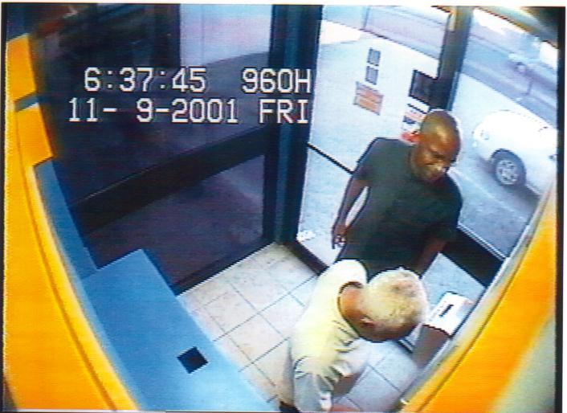
The Con
Here we see the Fraudster pretending to render assistance. What he is in fact trying to do is obtain the customer’s P.I.N now that he has captured the card

Slide 48
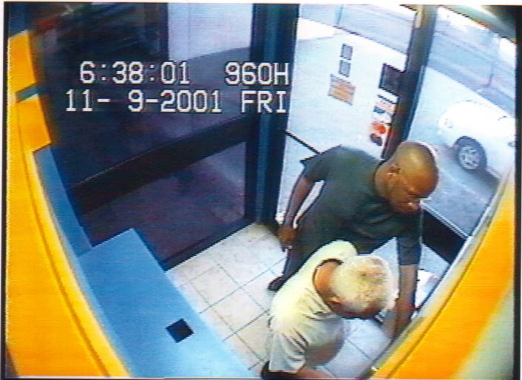
Obtaining the P.I.N
He convinces the customer that he would be able to retrieve his card if he entered his P.I.N while he holds down both the “cancel” and the “enter” buttons

Slide 49
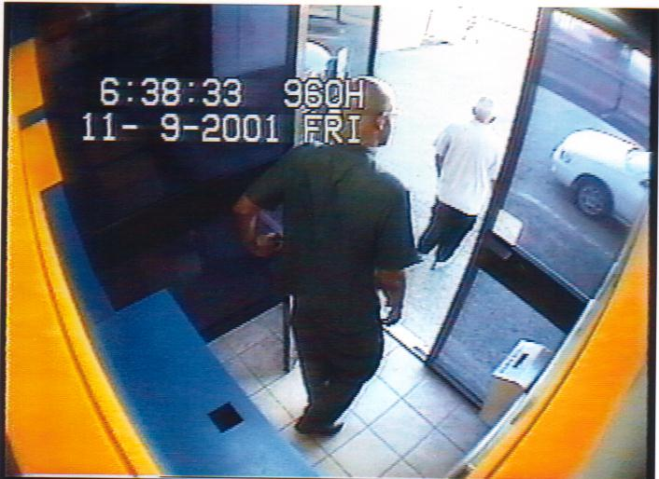
The Surrender
After several attempts the customer is convinced that the machine has captured his card. Both he and the Fraudster leave the ATM

Slide 50
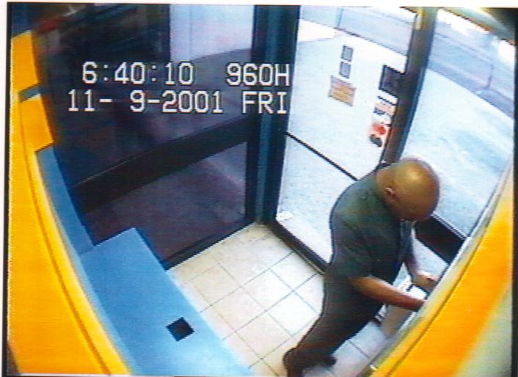
The Pickup
Satisfied that the coast is clear the Fraudster returns to retrieve the card that has been captured by his trap. He not only has the customers card he also has his P.I.N.

Slide 51
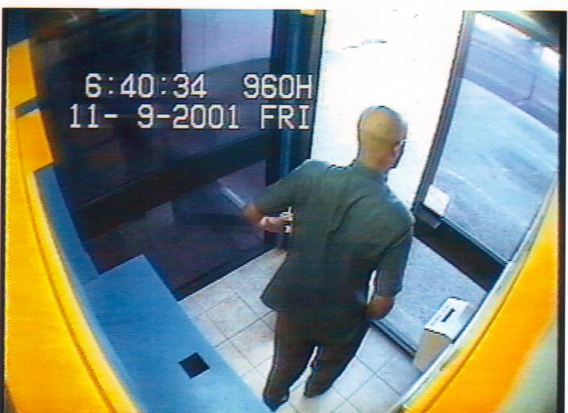
The Exit
Armed with card and P.I.N he left and was able to withdraw $1000 from the account

Slide 52
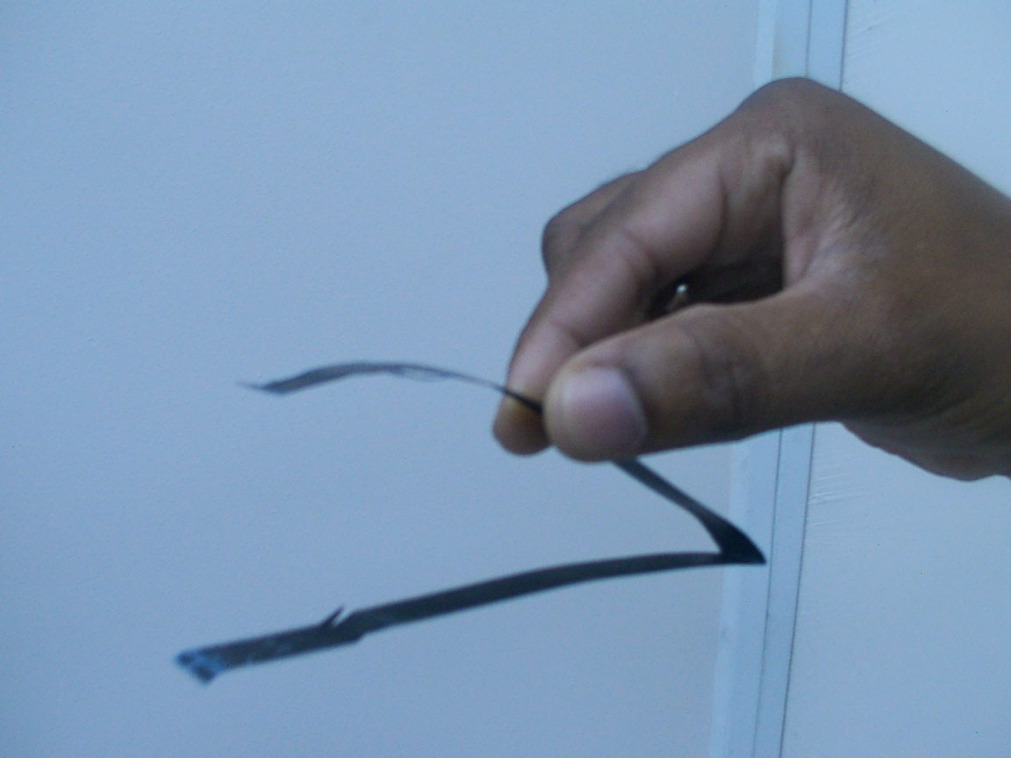
The Loop
The loop is made from a thin strip of X-Ray negative or similar type material. X-Ray negatives are preferred by the fraudsters since the color blends in well with the plastic housing of the card slot

Slide 53
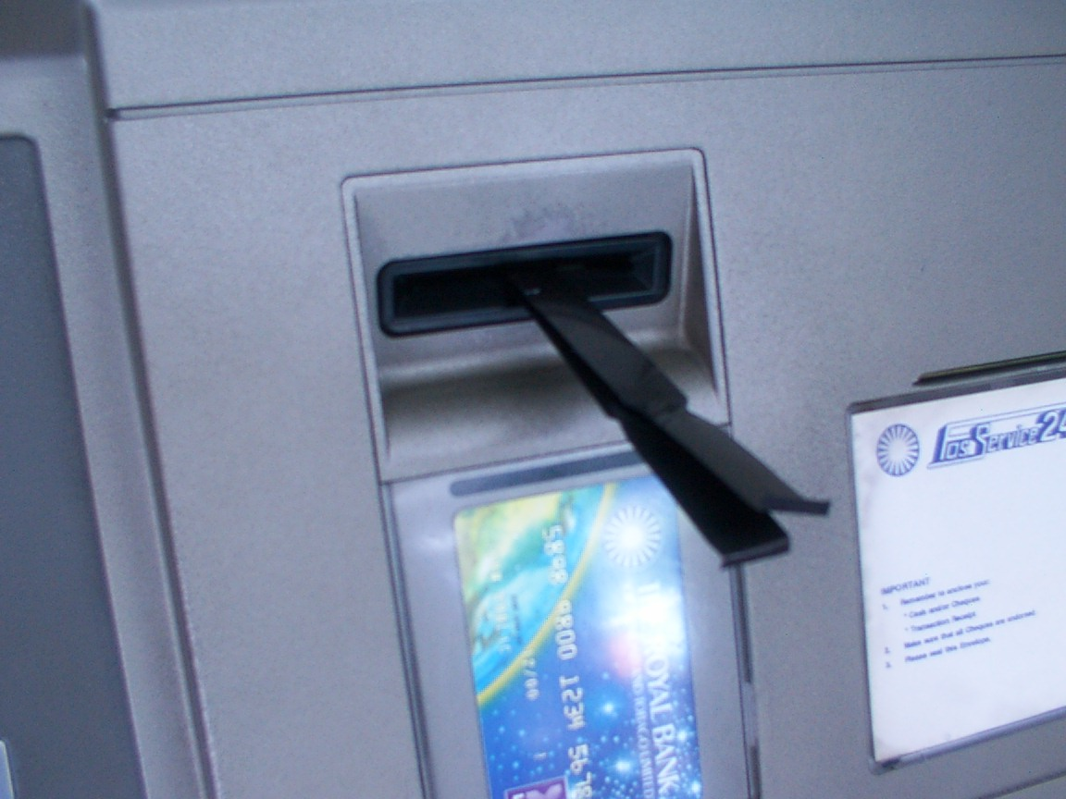
The Set
The strip is then inserted into the ATM card slot with use of an ATM card. Care is taken so as not to allow the card to be inserted all the way. The ends of the strip are then glued to the upper and lower portions of the slot

Slide 54
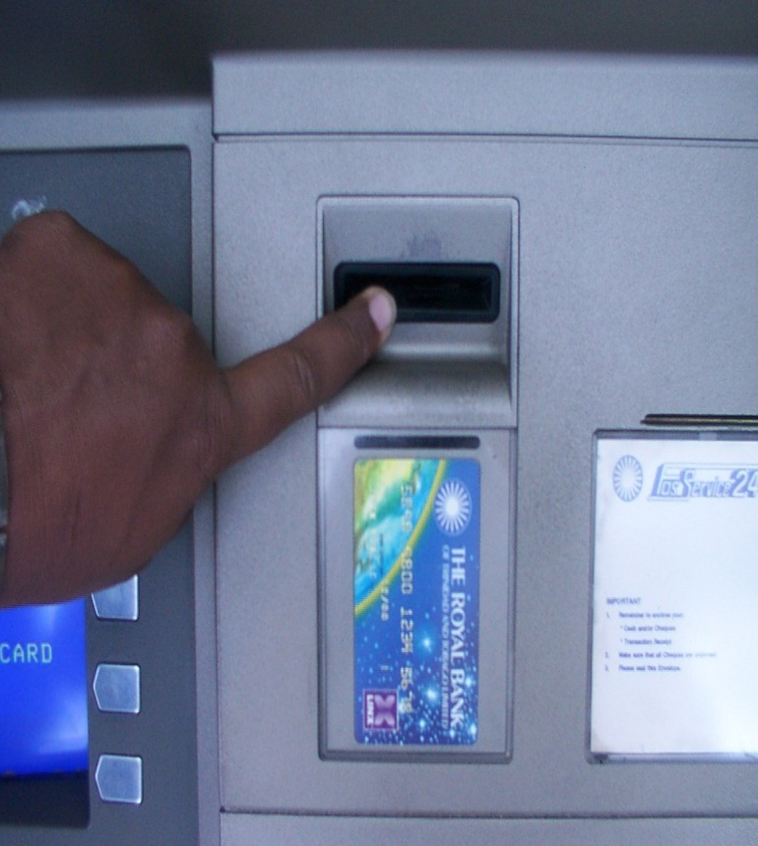
Invisible
Once the ends are glued it is almost impossible to the unsuspecting customer to detect

Slide 55
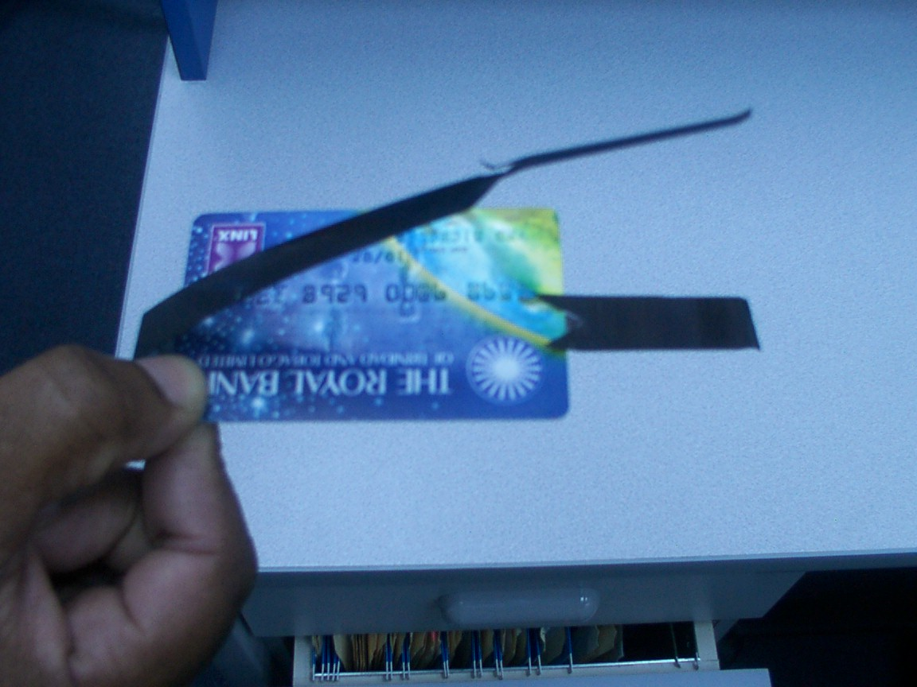
Why the card is captured
Slits are made on the upper and lower portions of the strip which prevent the card from being ejected after the completion of a transaction

Slide 56
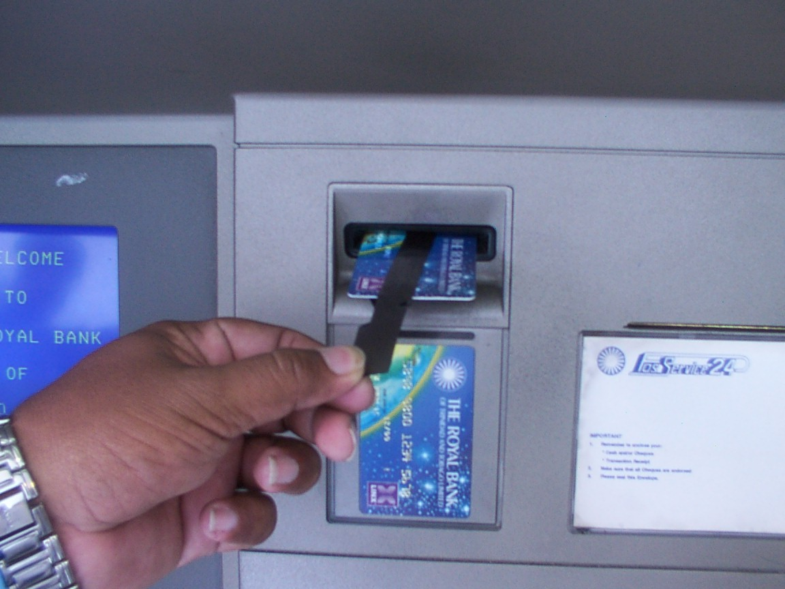
Retrieving the Card
Once the customer has left, and the PIN obtained, the fraudster would then detach the glued ends of the strip from the housing. Holding both ends of the strip he simply pulls and is able to retrieve the captured card

Slide 57
Prevention Techniques
Memorize your PIN.
Protect your PIN.
NEVER disclose your PIN to anyone.
Who will ask for you PIN?
Lost bankcard/credit card?
REPORT it!

Slide 58
Prevention Techniques
If your card is lost or stolen, notify your financial institution as soon as you can and cancel your card.
Sign all cards so that criminals may not sign the card with their signature.
NEVER loan your credit card to ANYONE

Slide 59
Prevention Techniques
If an ATM does not return card, contact your bank immediately and place a stop on the account.
Be wary of strangers wanting to help you if you are having troubles with a particular ATM.

Slide 60
The Four “D’s” of Fraud Prevention
D
Deter
Delay
Deny
Detect

Slide 61
Resources
PhoneBusters – National Telephone Fraud Complaint/Information Centre
www.phonebusters.com
1-888-495-8501
Better Business Bureau – Edmonton
www.edmontonbbb.org
1-780-482-2341
Canadian Marketing Association – Do not call service. Removing your name from their list.
www.cornerstonewebmedia.com/cma/submit.asp
1-416-441-406
RECOL – (RCMP) www.recol.ca

Slide 62
Questions?

